Slide 1

presentation
Card outcome probability calculator

Slide 2

Key features:
Single card outcome
Double card outcome
Simulation mode

Slide 3
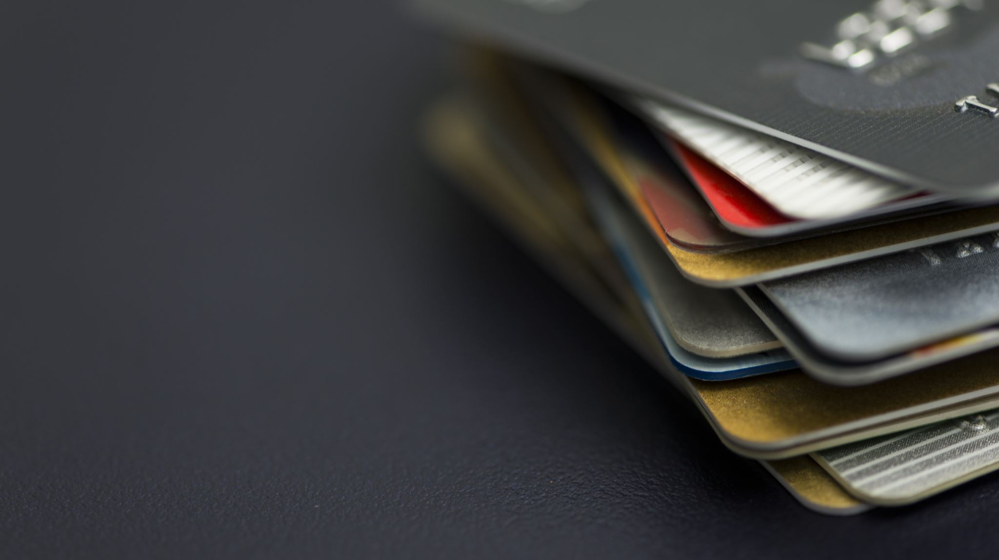
Single card outcome

Slide 4
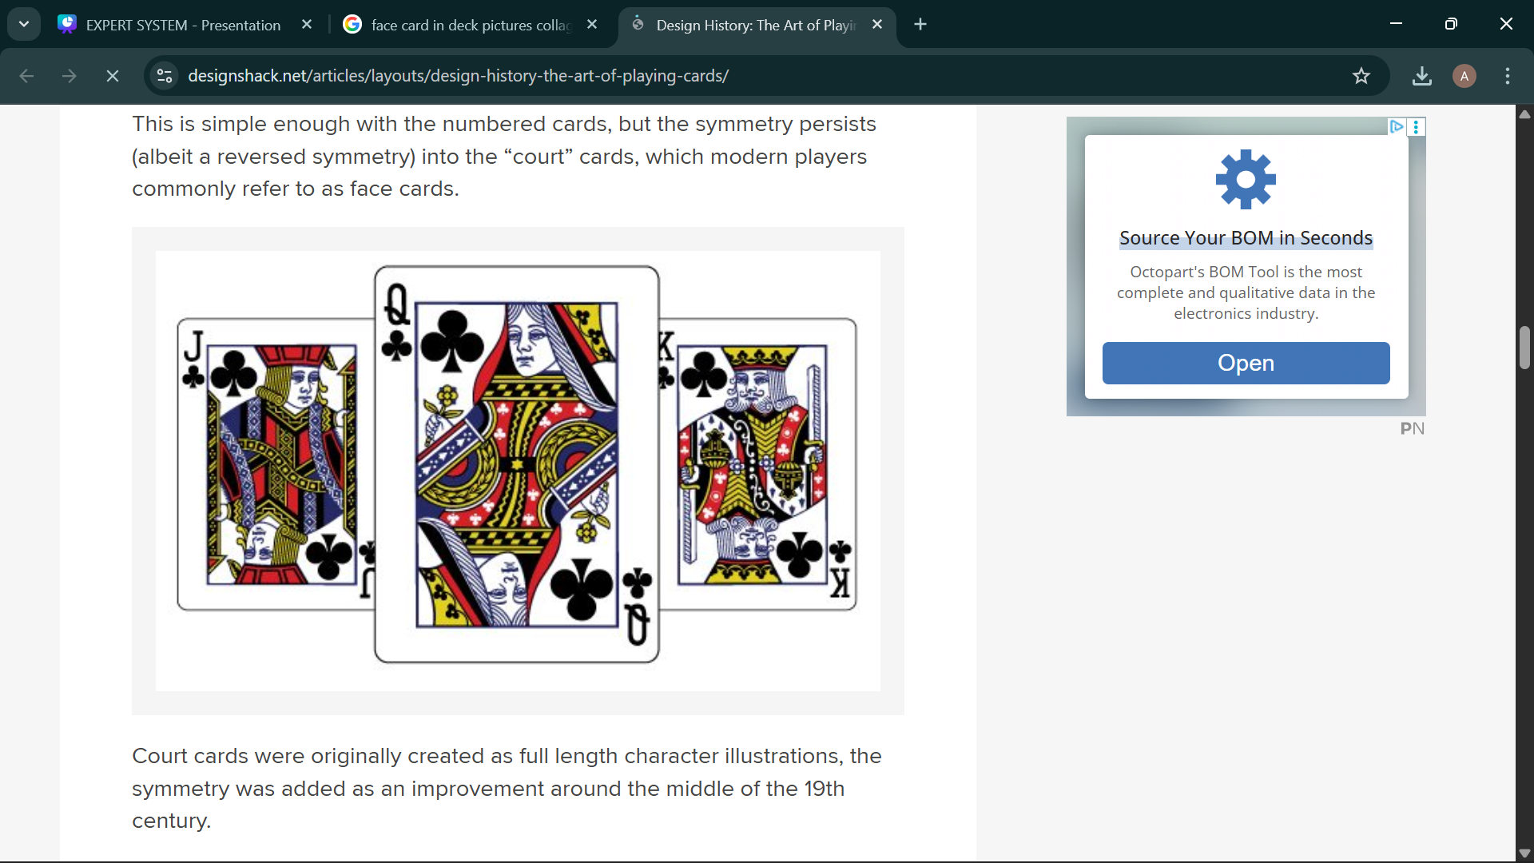
Face Card Probability:
Calculates the probability of drawing any face card (Jack, Queen, or King) from the deck.

Slide 5
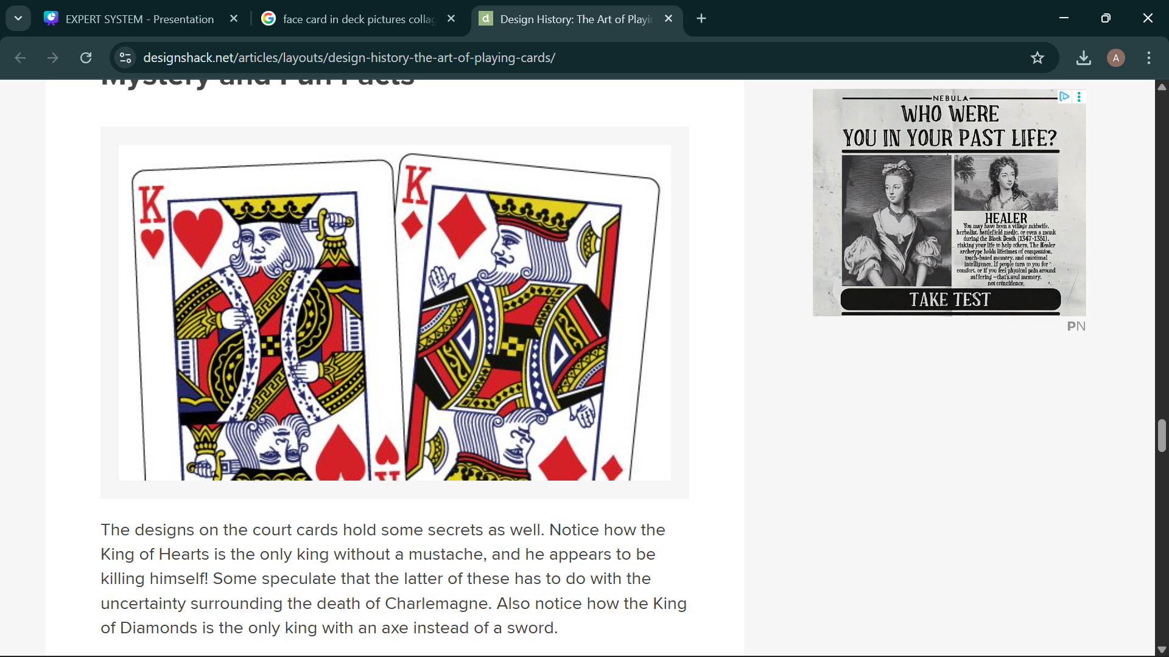
Specific Face Card Probability:
Calculates the probability of drawing a specific face card such as Jack, Queen, Joker. or King.

Slide 6
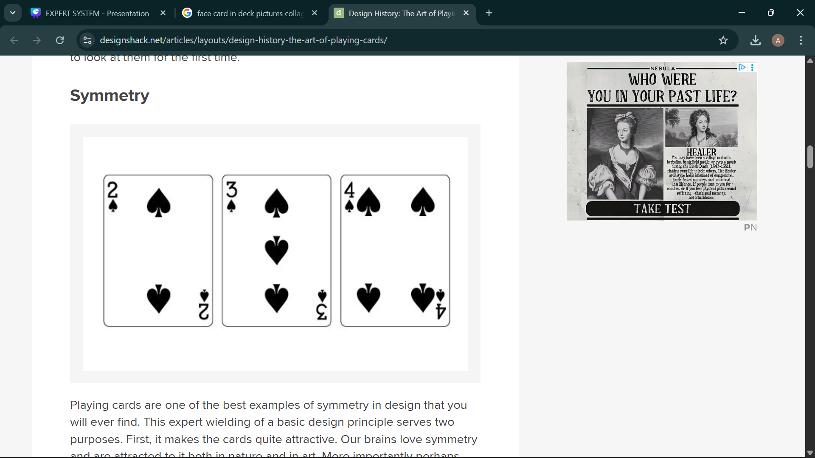
Number Card Probability
Calculates the probability of drawing a number card (2–10) from the deck.

Slide 7
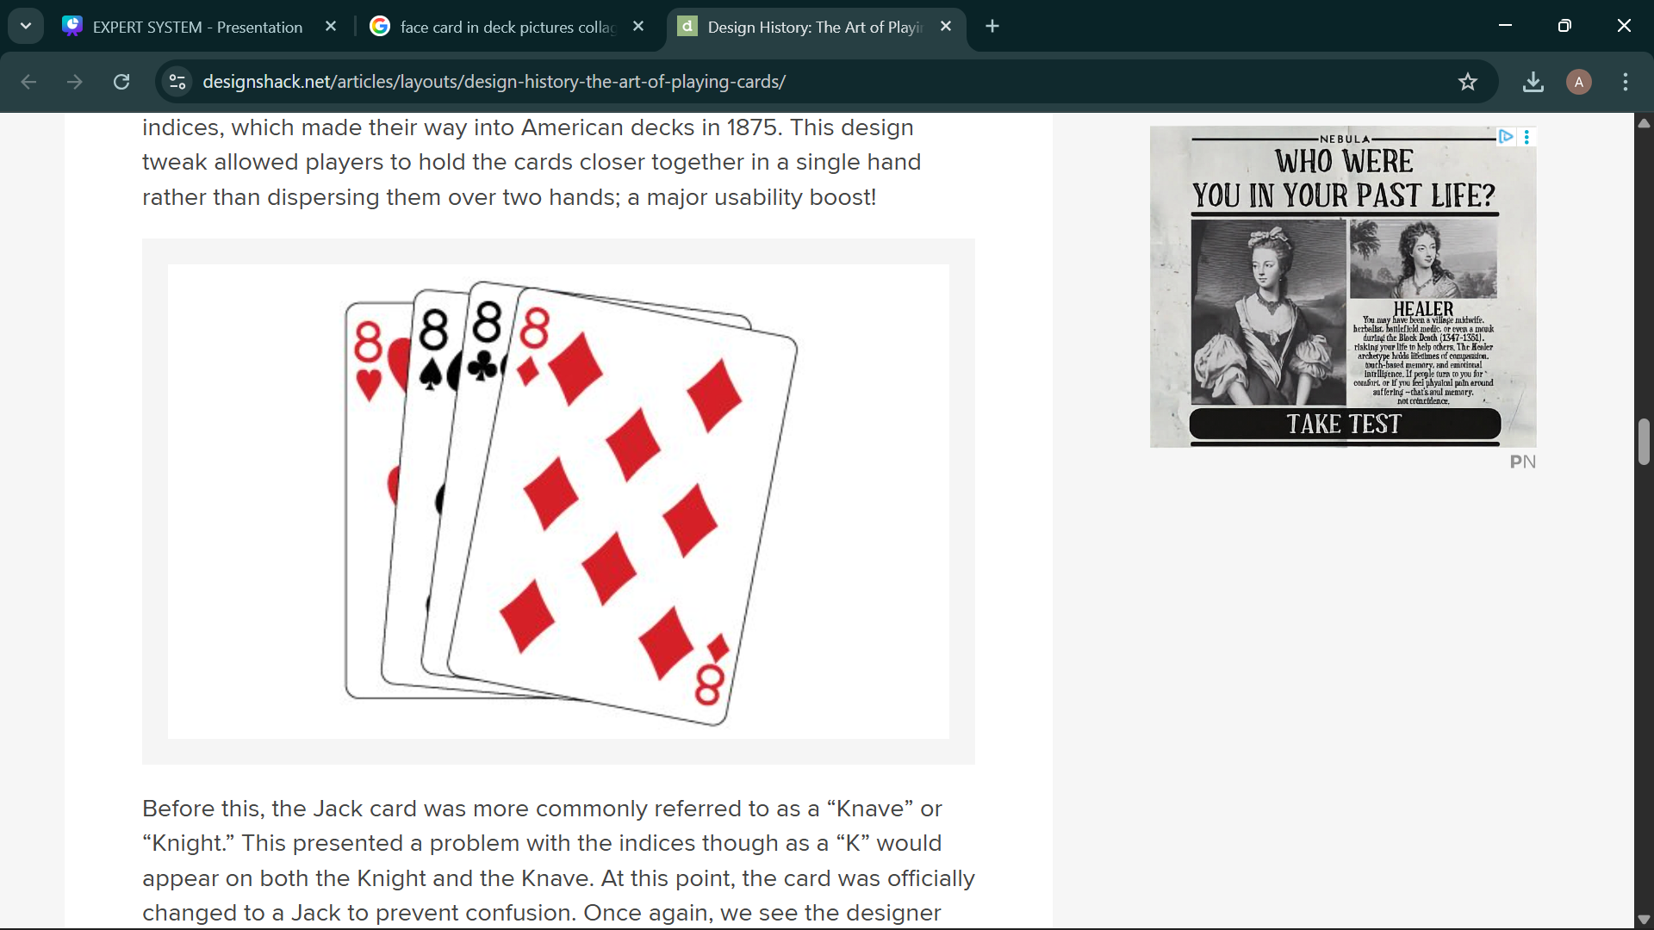
Specific Number Card Probability
Calculates the probability of drawing a specific number card chosen by the user.

Slide 8
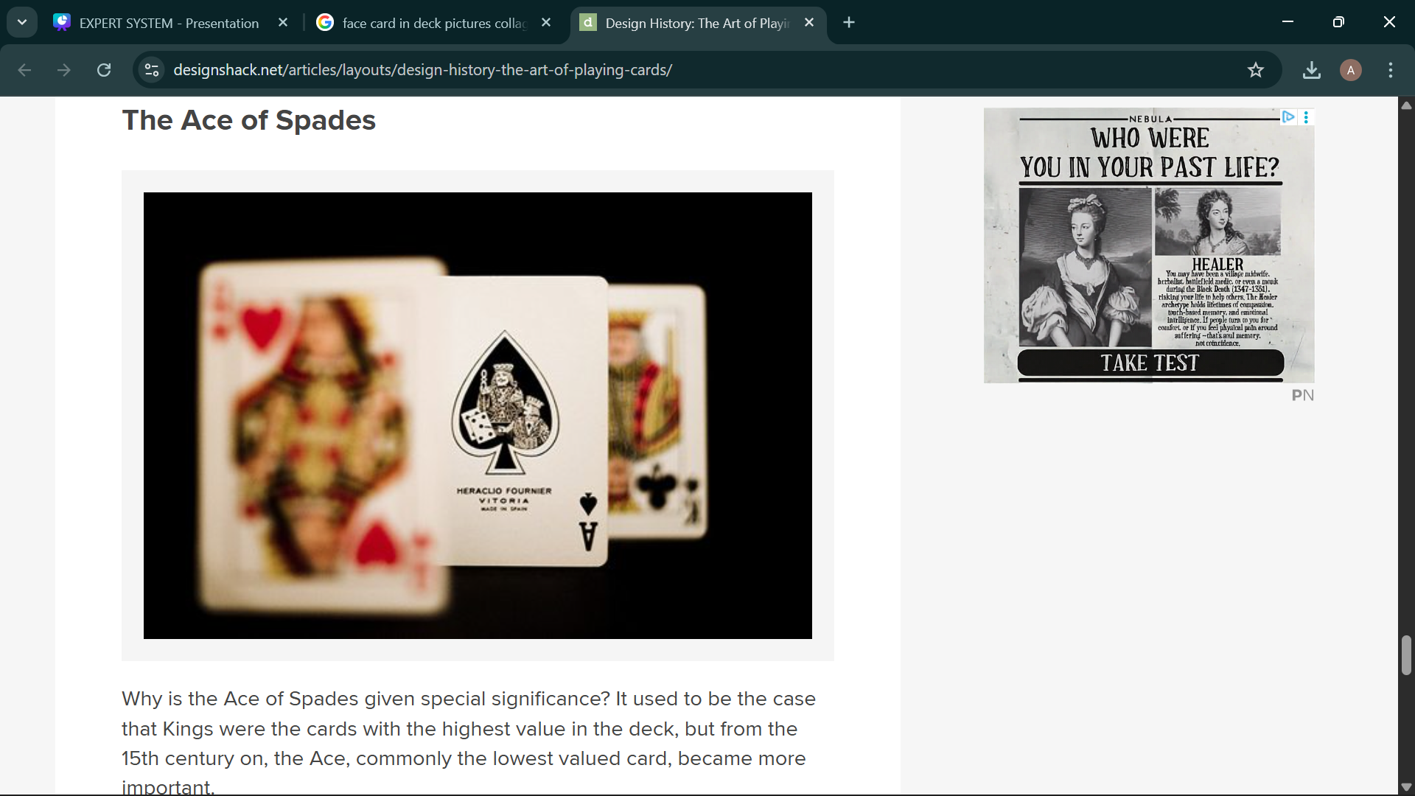
Ace Probability:
Calculates the probability of drawing an Ace from the deck.

Slide 9
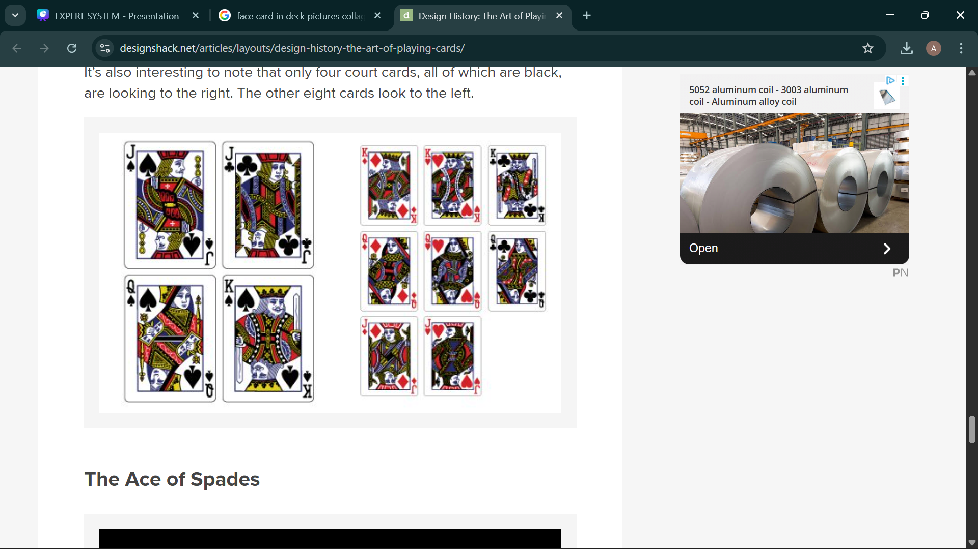
Specific Card Probability:
Calculates the probability of drawing one exact card from the deck.

Slide 10
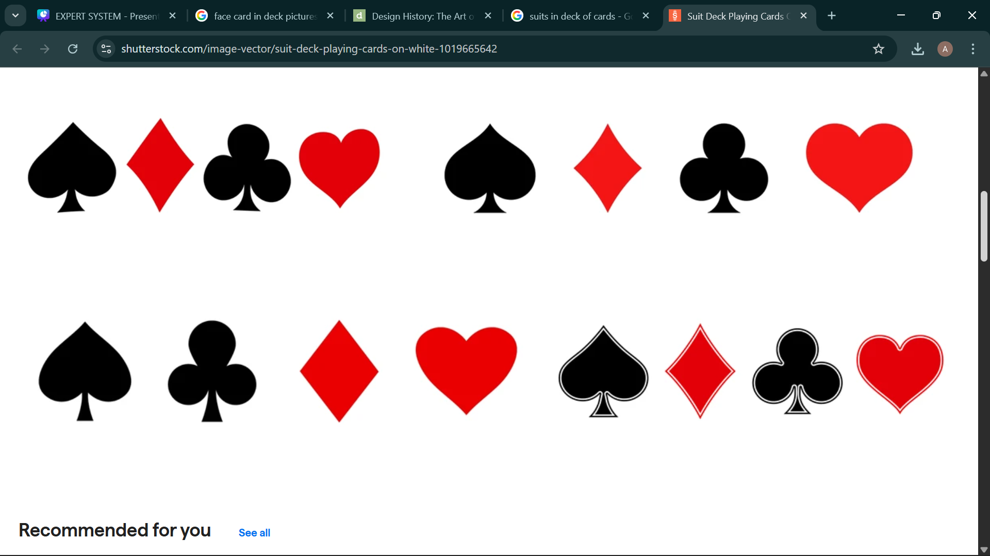
Specific Suit Probability:
Calculates the probability of drawing a card from a specific suit (Hearts, Diamonds, Clubs, or Spades).

Slide 11
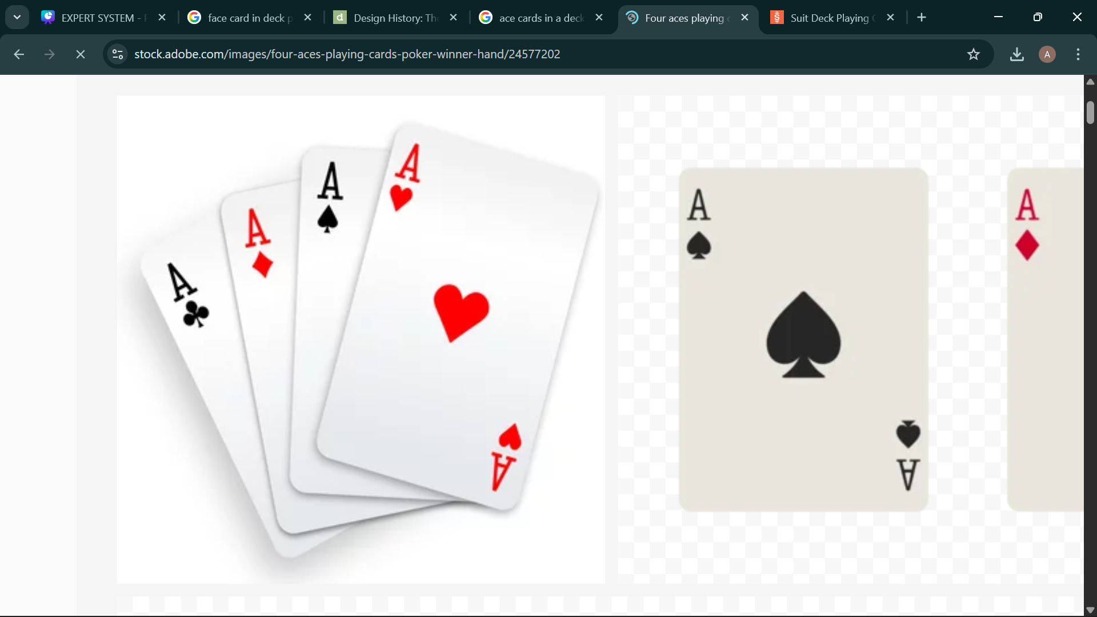
No-Ace Probability:
Calculates the probability of not drawing an Ace.

Slide 12
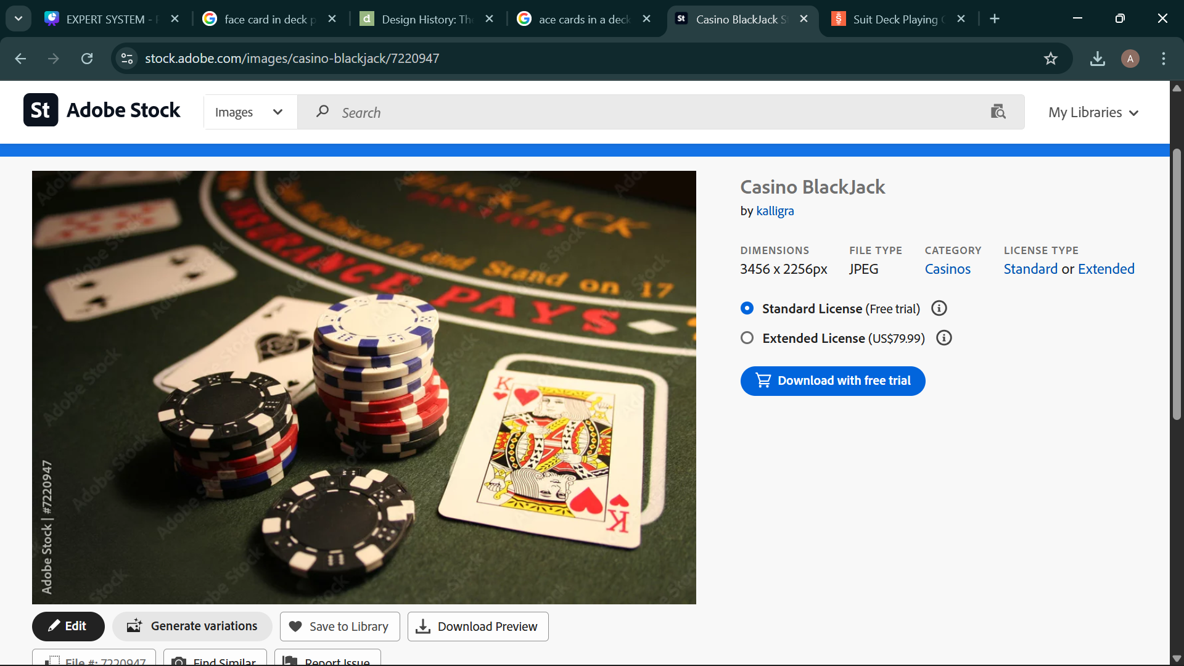
Multiple card draws

Slide 13
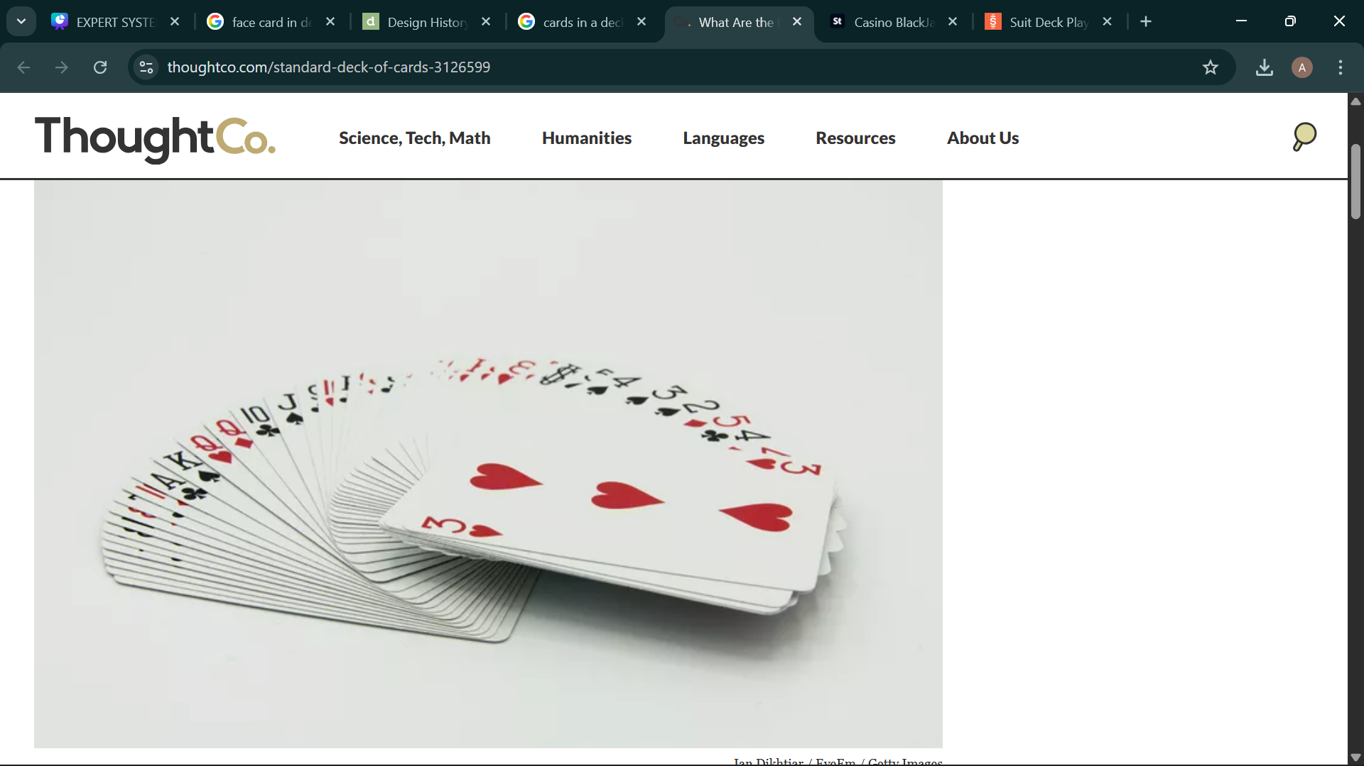
Same Rank Probability:
Calculates the probability that two drawn cards have the same rank.

Slide 14

One Ace and One Non-Ace Probability:
Calculates the probability of drawing one Ace and one non-Ace card.

Slide 15
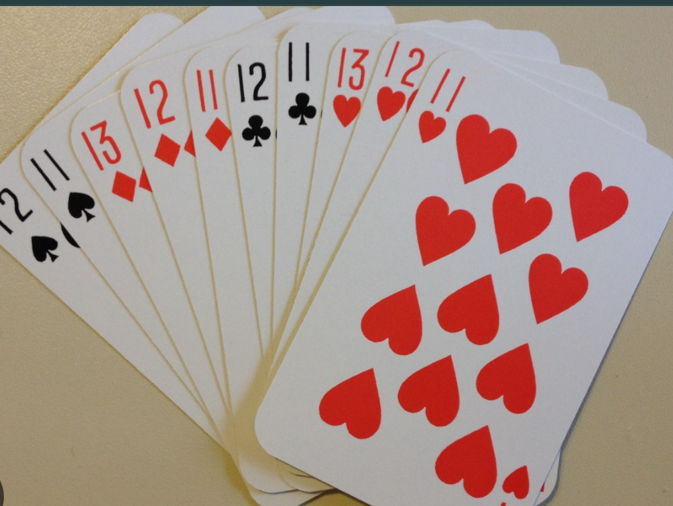
Same Color Probability:
Calculates the probability that both drawn cards are of the same color (red or black).

Slide 16

Simulation mode

Slide 17
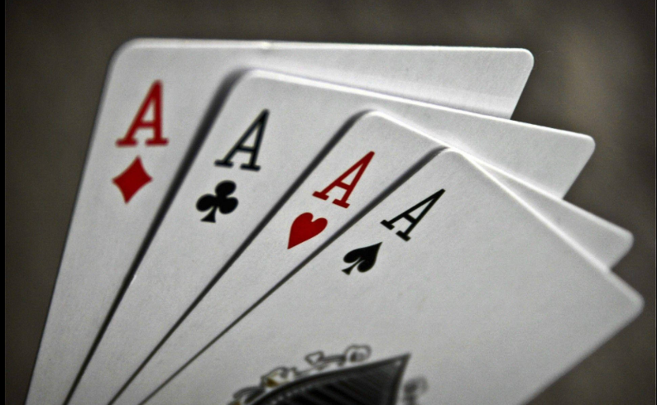
Ace Probability Simulation:
Uses random card draws to estimate the probability of drawing an Ace

Slide 18
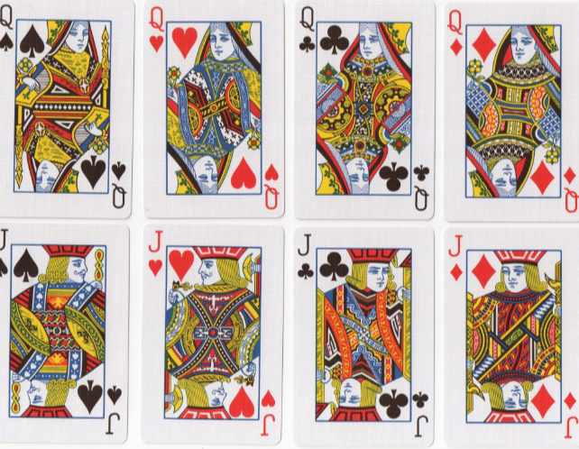
Face Card Probability Simulation:
Uses simulation to estimate the probability of drawing a face card.

Slide 19
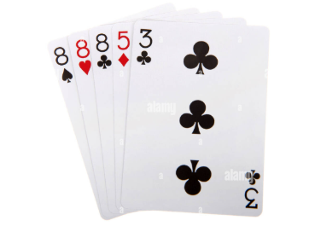
Same Rank Simulation:
Simulates two card draws to estimate the probability of drawing cards with the same rank.

Slide 20

thanks
Credits: azbah Naveed & noorulain
Instructor: Prof. waqas ali

